Slide 1
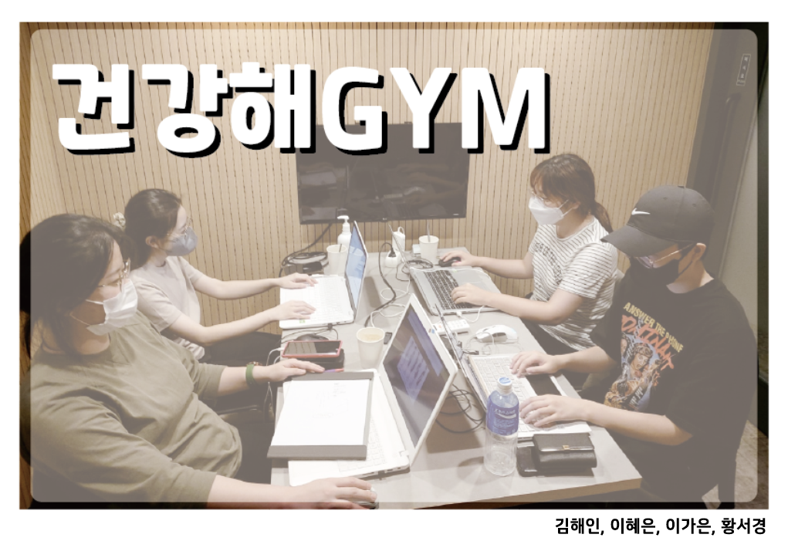
Notes:
안녕하세요. 저희는 건강해짐 팀입니다.

Slide 2
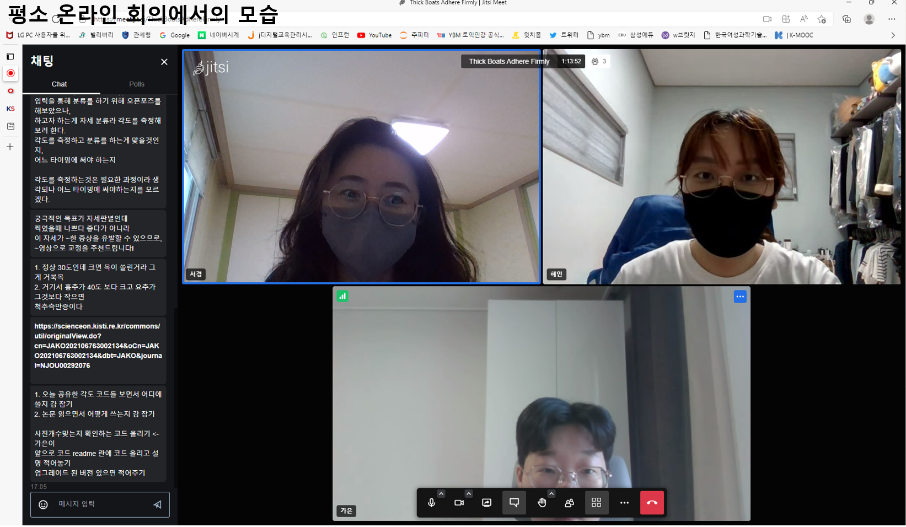
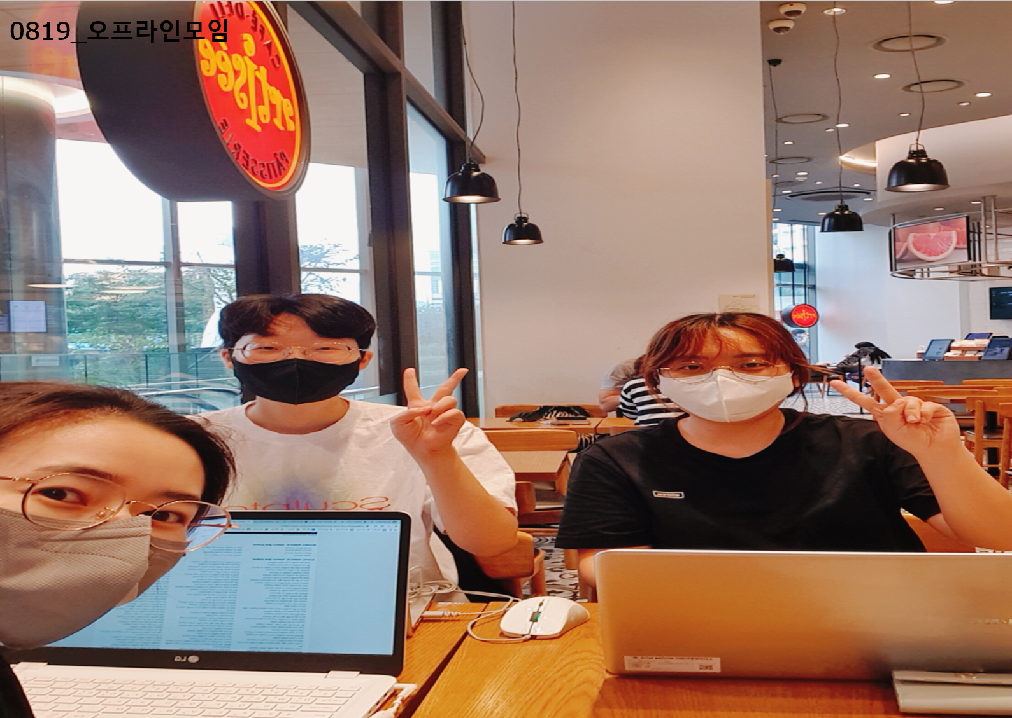
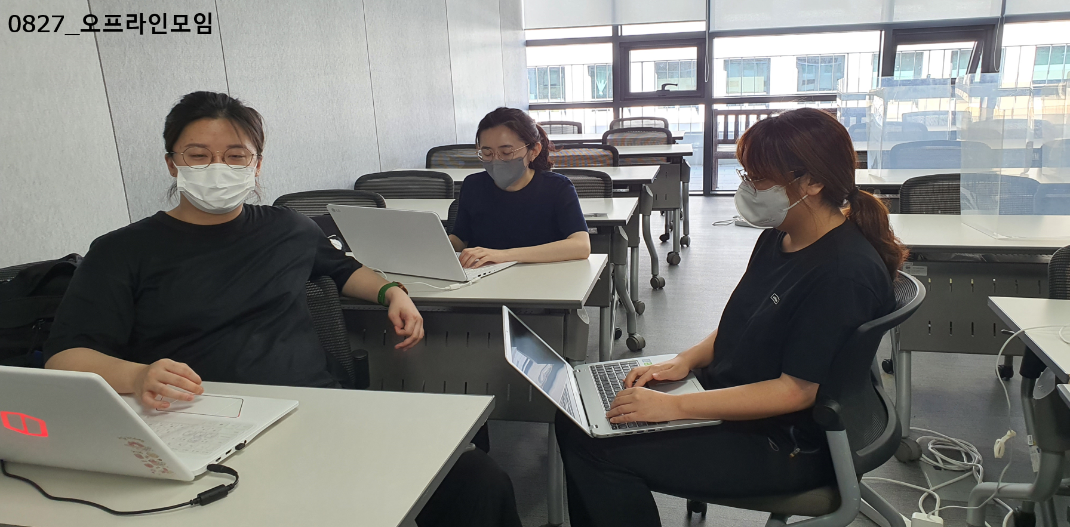
Notes:
안녕하세요 이번 공개sw

Slide 3
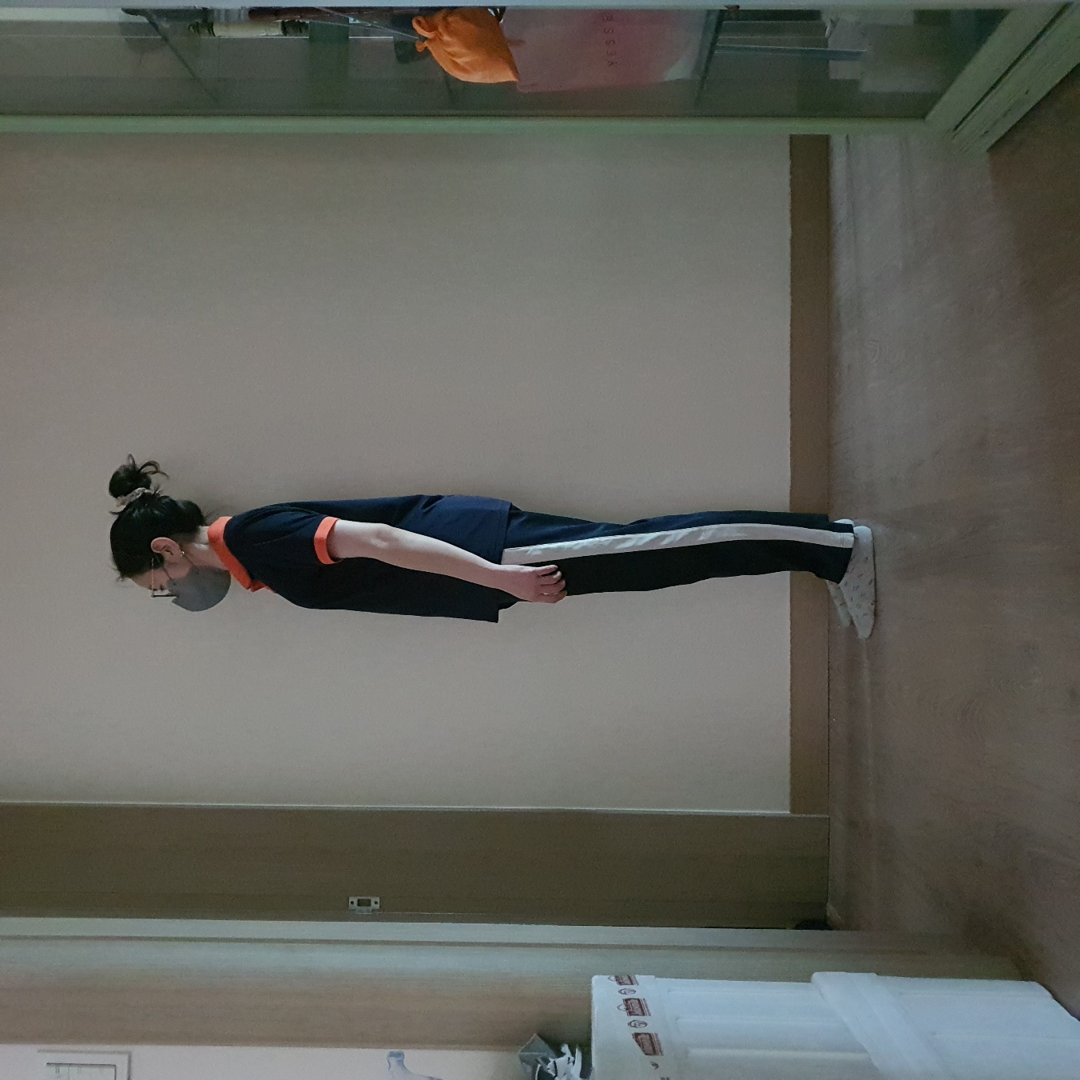
Image
Pre-processing
Segmentation
Labelling
Data Analysis

Slide 4
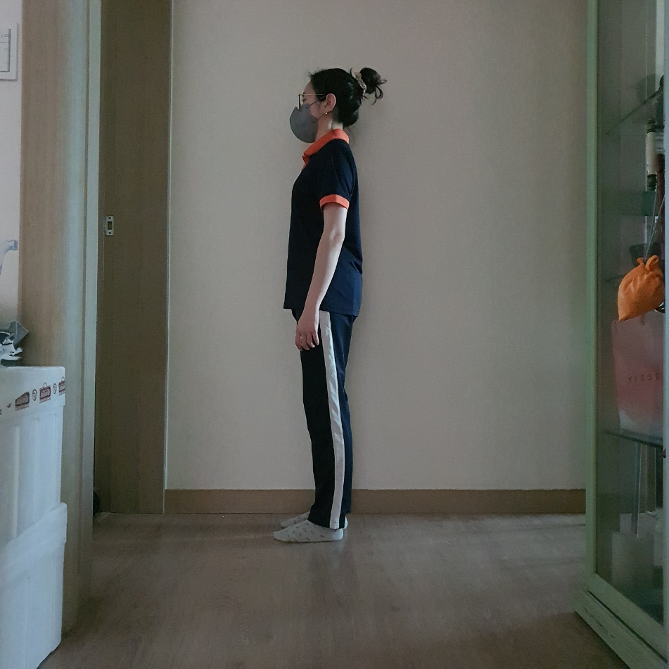
Image
Pre-processing
Segmentation
Labelling
Data Analysis

Slide 5
Image
person
Pre-processing
Segmentation
Labelling
Data Analysis

Slide 6
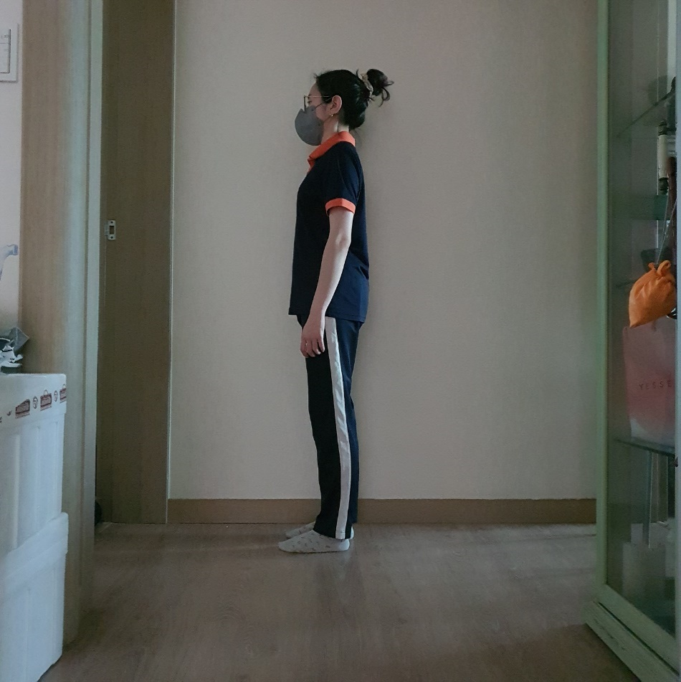
Image
Pre-processing
save
Segmentation
Labelling
Data Analysis

Slide 7
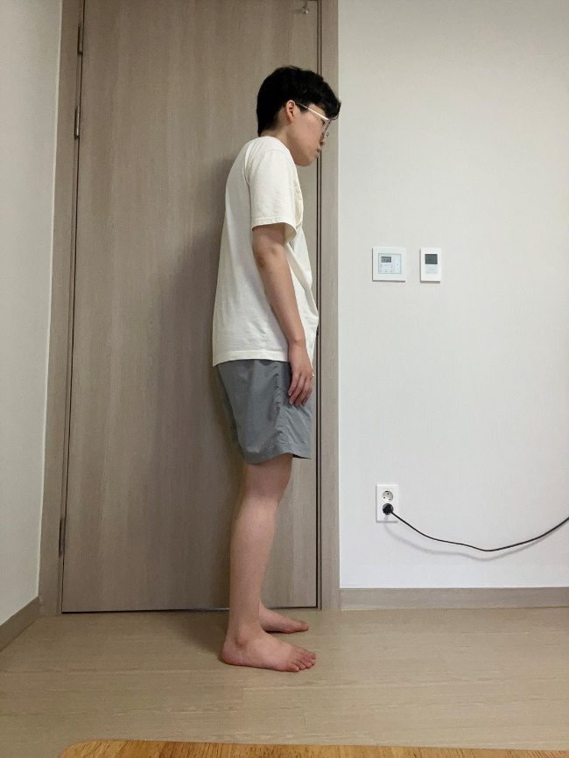
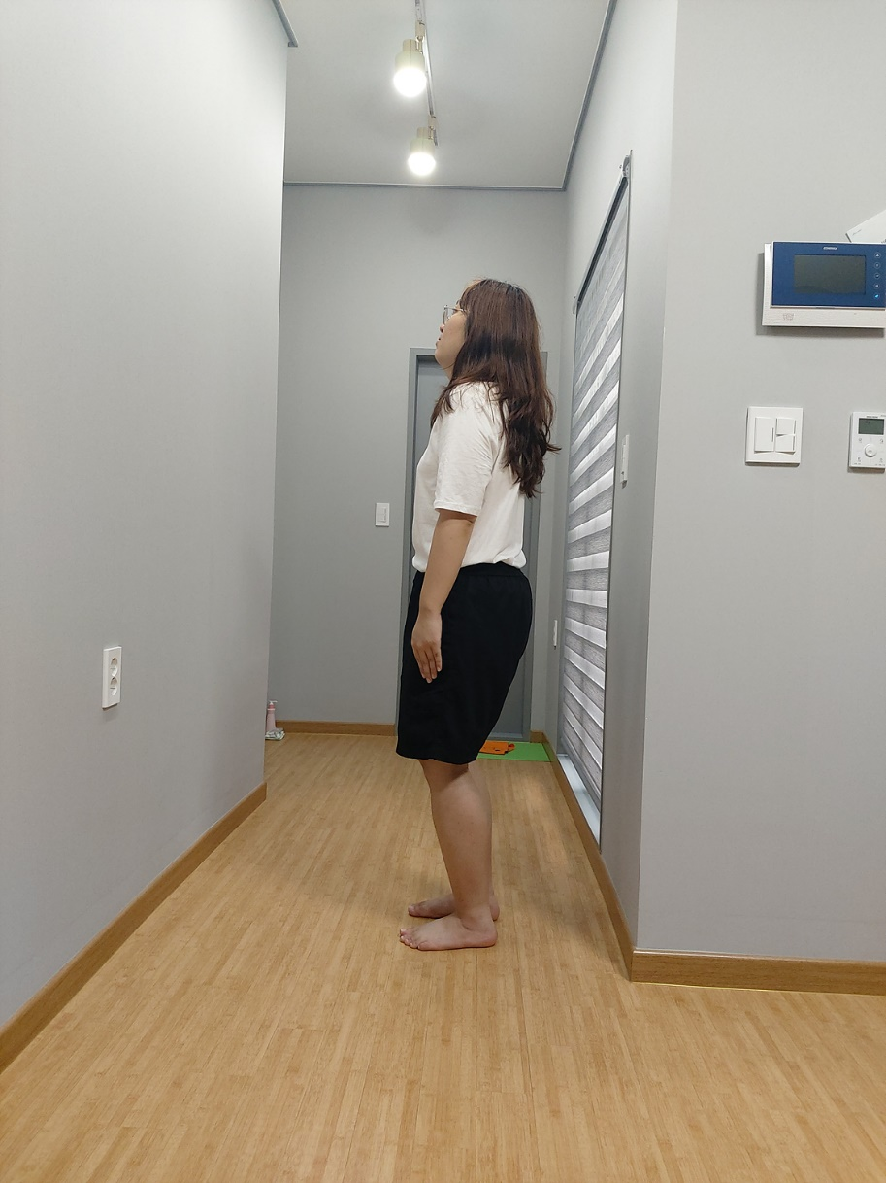
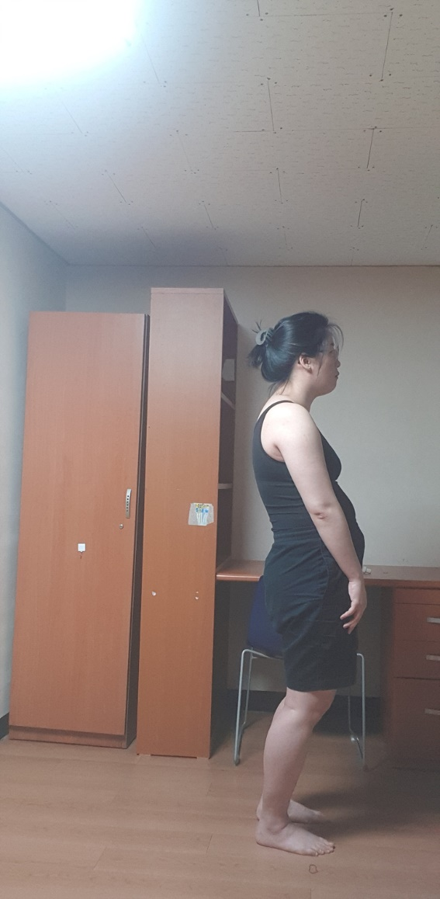
Image
Pre-processing
Segmentation
Labelling
Data Analysis
Bad1
Bad2
Bad3
Good

Slide 8
Image
Pre-processing
Segmentation
Labelling
Bad1
Bad2
Bad3
Good
Data Analysis
label
0
1
2
3

Slide 9
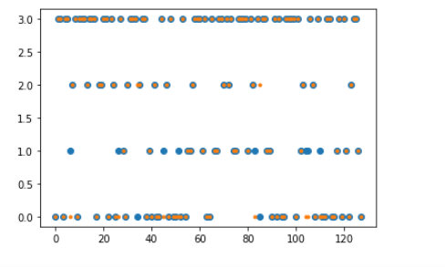
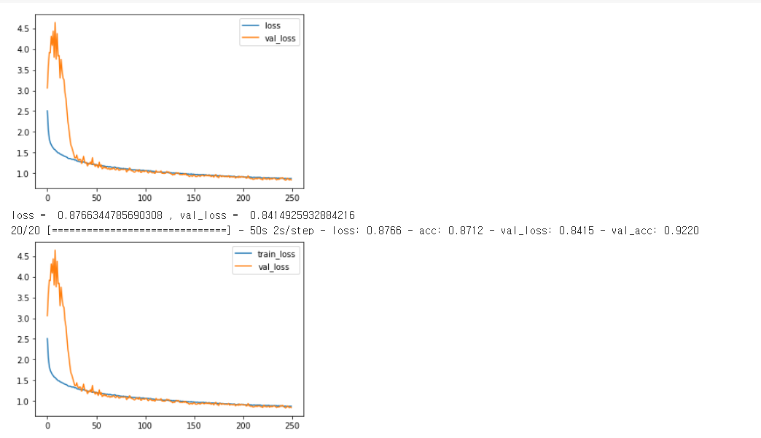
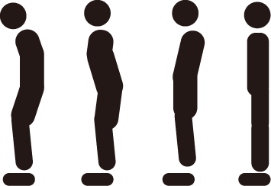
실행 결과
Data Analysis
loss : 0.8766
acc: 0.8712
0 1 2 3

Slide 10
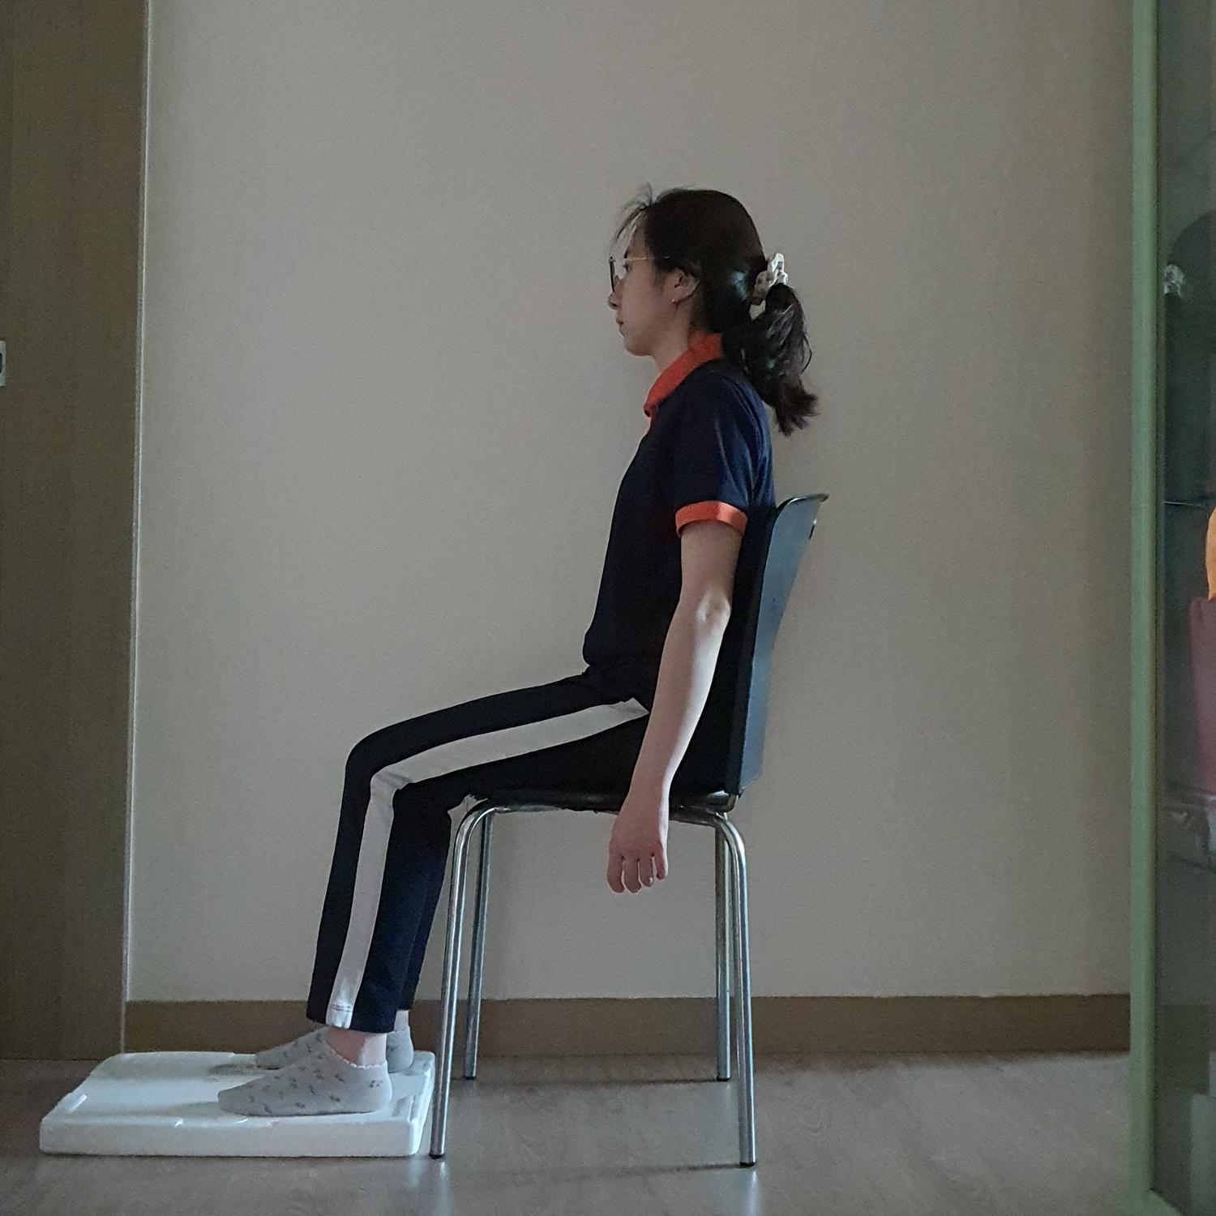
Image
Pre-processing
Segmentation
Labelling
Data Analysis

Slide 11
Image
Pre-processing
Segmentation
Labelling
Data Analysis

Slide 12
Image
person
Pre-processing
Segmentation
Labelling
Data Analysis

Slide 13
Image
Pre-processing
save
Segmentation
Labelling
Data Analysis

Slide 14
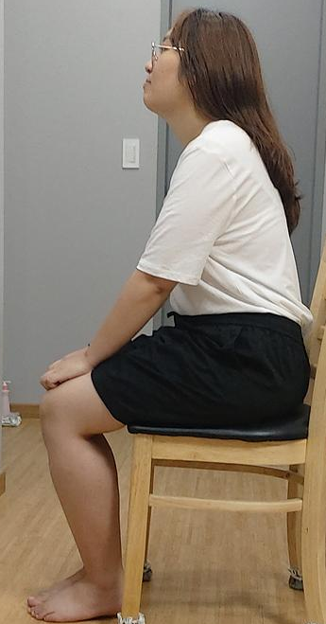
Image
Pre-processing
Segmentation
Labelling
Data Analysis
Good
Bad

Slide 15
Image
Pre-processing
Segmentation
Labelling
Data Analysis
Good
Bad
label
0
1

Slide 16

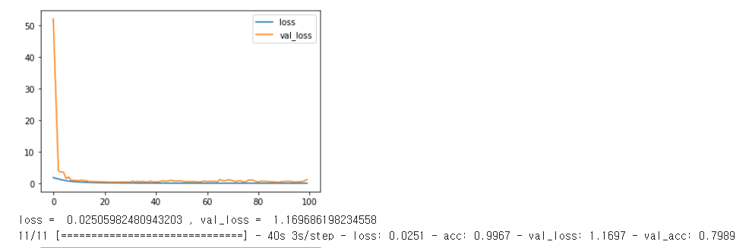
실행 결과
Data Analysis
0
1
loss : 0.0251
acc: 0.9967

Slide 17
실행 결과
Data Analysis
0
1
loss : 0.0251
acc: 0.9967

Slide 18
감사합니다

